Slide 1
GitHub
How to Clone a Repository

Slide 2
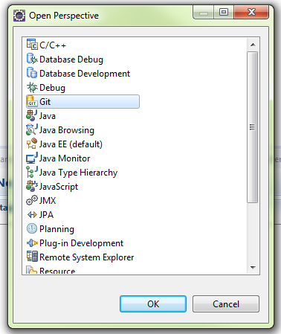
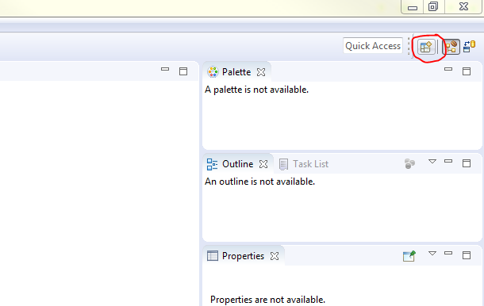
Install Eclipse Oxygen: https://www.eclipse.org/downloads/
Once installed and created a new workspace, you need to open the GIT perspective:

Slide 3
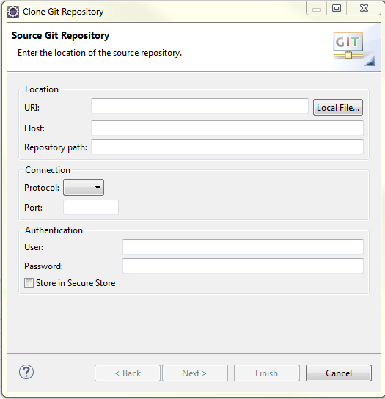
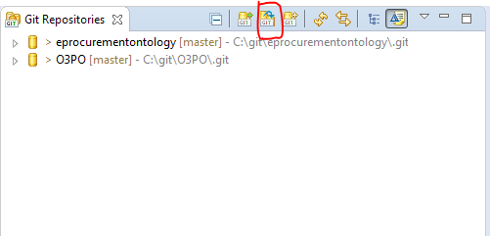
3. Clone a GIT repository:

Slide 4
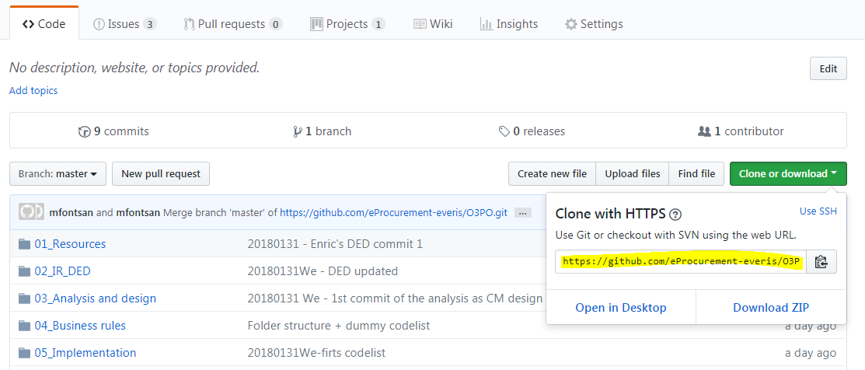
4. Copy the clone URL from GitHub:
4.1. Access to our GitHub website: https://github.com/eProcurement-everis/O3PO
4.2. Copy “Clone or download” URL: https://github.com/eProcurement-everis/O3PO.git

Slide 5
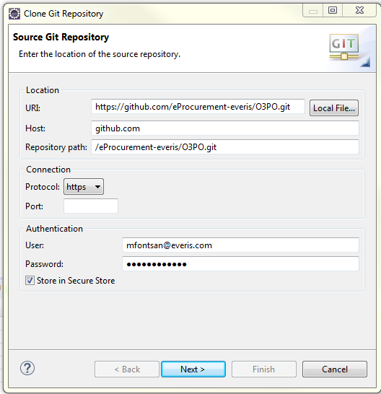
5. Copy the clone URL from GitHub to Eclipse:
Location / URI: https://github.com/eProcurement-everis/O3PO.git
Host (automatic): github.com
Repository path (automatic): /eProcurement-everis/O3PO.git
Connection: -
Authentication: the user and password of you GitHub
6. Next and Next until you can press Finish.

Slide 6
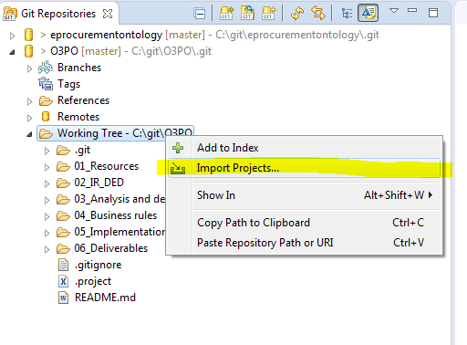
7. The Git repository has been saved locally.
8. On the Working tree folder, Import the project; so you will be able to make changes:

Slide 7
GitHub
How to Commit a change

Slide 8
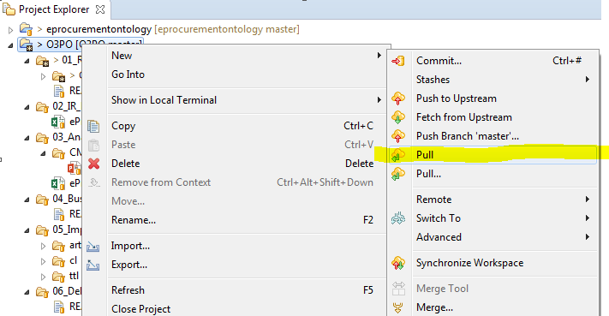
Before doing any commit, please remember to Pull in order to update the project in case there is any change from other users:

Slide 9
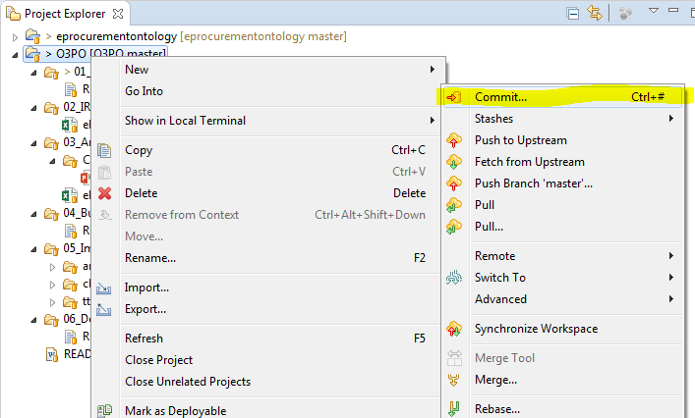
1. Project / Team / Commit:

Slide 10
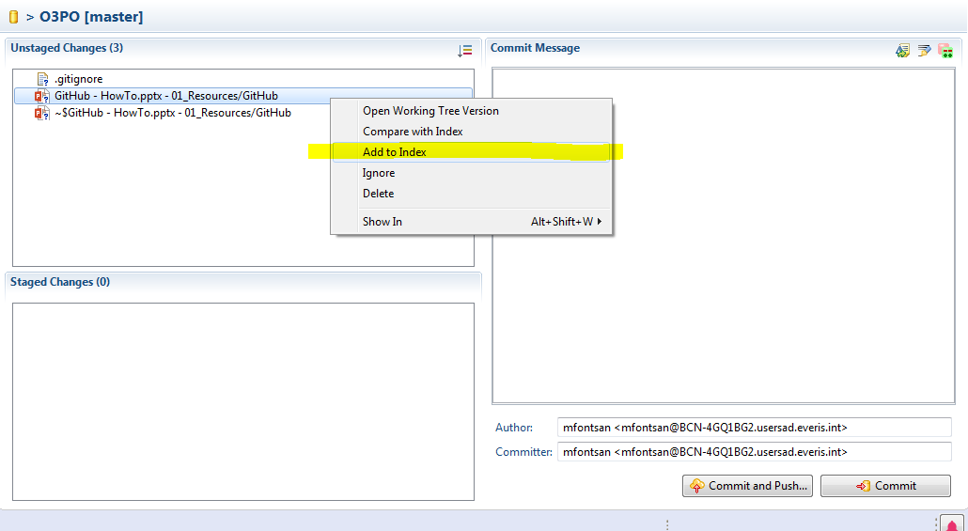
2. Git Staging window will show the files that have changes.
3. As only the files in the “Staged Changes” window will be committed, please, add the unstaged files into the Index:

Slide 11
4. Write a “commit message”. Please follow the structure:
YYYYMMDD – DD Message
For example: 20180301 – Th First commit of the GitHub Manual
5. “Commit and Push…” means save the changes locally and push them into the GitHub website; so they are available for everyone.
6. “Commit” means save the changes locally, but they will not be available until they are pushed into the GitHub website.

